Slide 1
Theory and Practice of Agent-Based Modeling

Slide 2
Goals
What is an agent-based model?
Why construct agent-based models?
What are the parts of an agent-based model?
How does one construct agent-based models?

Slide 3
What is an agent-based model?

Slide 4
What is an agent-based model?
Computer simulation
Agent
Environment
Agent
Agent

Slide 5
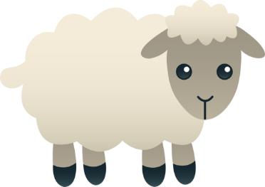
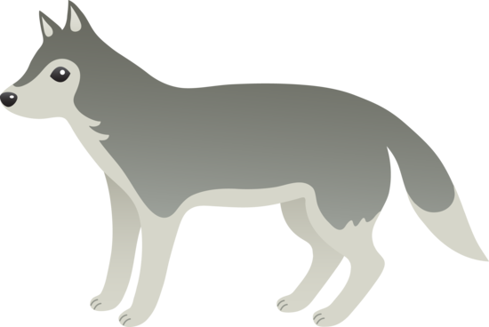
What is an agent-based model?
Predator-prey models
Grass

Slide 6
Why construct agent-based models?

Slide 7
Why construct agent-based models?
What kinds of questions are agent-based models good for?
How do they help with those questions?

Slide 8
What questions are agent-based models good for?
Wilensky and Rand (2015):
Integrative questions
Differential questions

Slide 9
Integrative questions
How does some psychology extrapolate out at group level?
?
Racial Bias
Racial Inequality

Slide 10
Integrative questions
How does some psychology extrapolate out at group level?
?
Conformity
Emergence of norms

Slide 11
Differential questions
What psychologies can explain some observed phenomenon?
?
Neighborhood preferences
Racial Segregation

Slide 12
Mate choice example
What is known:
1. People have mate preferences
2. People select mates
3. People’s mates do not strongly match their preferences
What could explain this?
1. People do not act on their mate preferences
2. People attempt to fulfill their preferences, but are constrained

Slide 13
Differential questions
What psychologies can explain some observed phenomenon?
?
Ineffectual preferences
Constraints on mate choice
Weak preference fulfillment

Slide 14
How do agent-based models help?
An agent-based model is a way of:
Expressing a hypothesis
Deriving predictions

Slide 15
How do agent-based models help?
Usually:
Hypotheses: Words
Predictions: Reasoning
Hypothesis 1:
“If people do not act on their preferences, then mates will not fulfill preferences”
Hypothesis 2:
“If people are constrained, then mates will not fulfill preferences”
Agent-based model:
Hypotheses: Computer code
Predictions: Observation
Hypothesis 1:
Create world where agents do not act on preferences
Observe
Hypothesis 2:
Create world where agents act on preferences but are constrained
Observe
Then: compare predictions to data

Slide 16
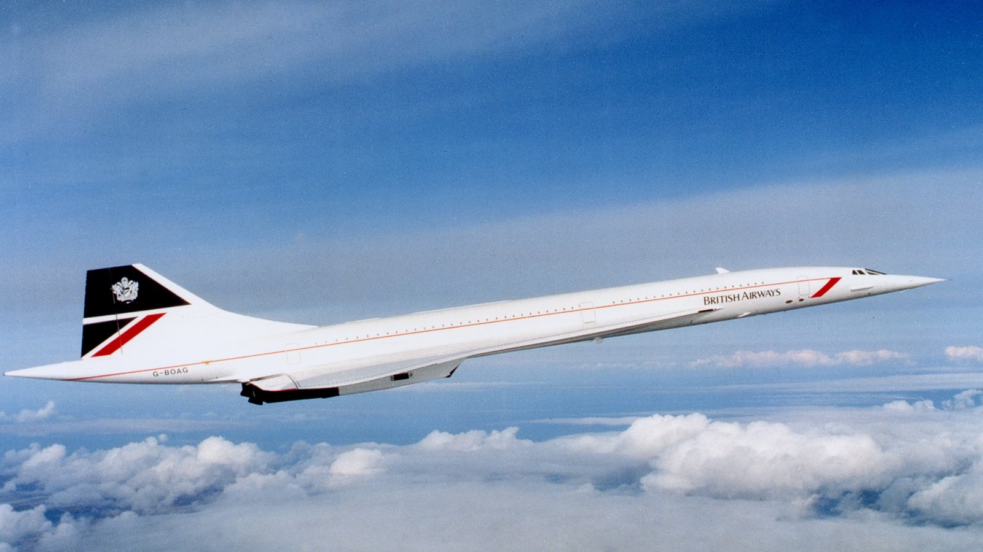
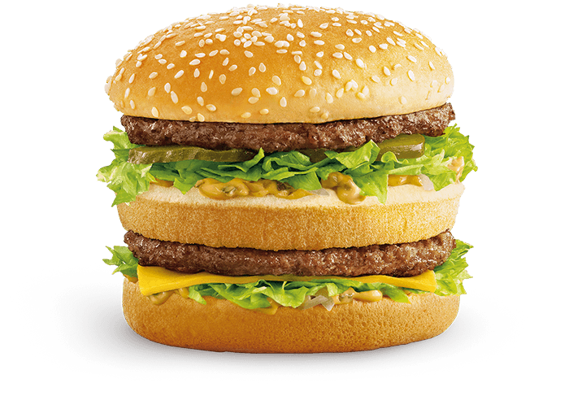
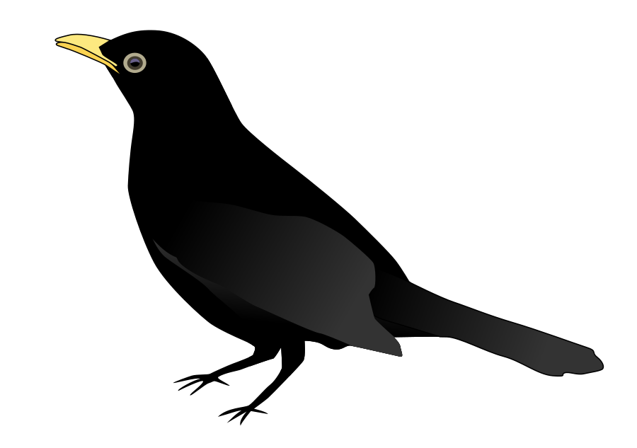

Human reasoning is fallible
Sometimes we reason incorrectly
Trivers, 1972
Dawkins, 1976
Coleman and Gross, 1991

Slide 17
Human reasoning is fallible
Some hypotheses are too complex to reason through
Mate choice constraints:
Availability of preference-fulfilling mates
Presence of competitors
Requirement of mutual attraction
How predictive should mate preferences be?

Slide 18
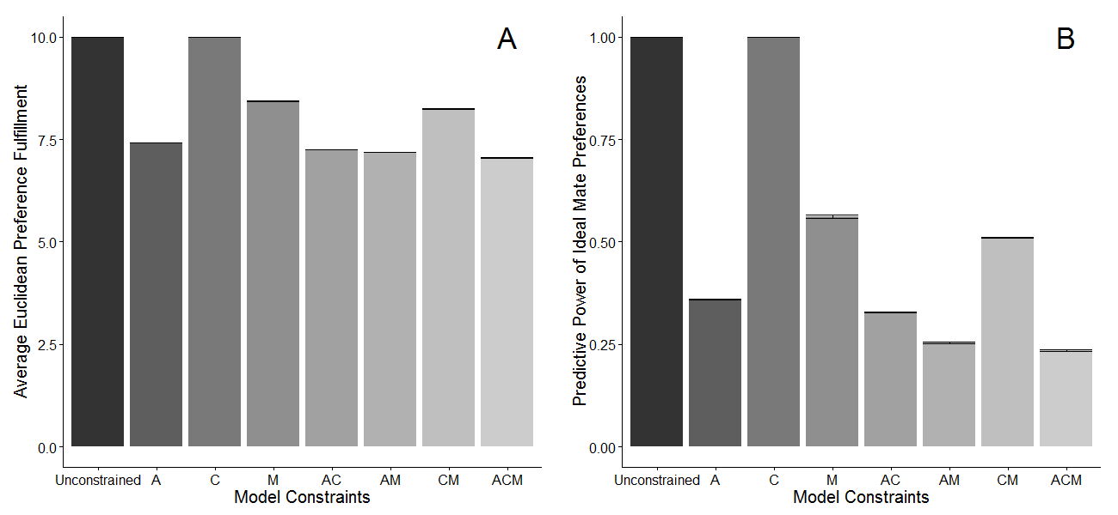
Conroy-Beam & Buss, 2019

Slide 19
Models facilitate communication
Our assumptions are often implicit
Computer code forces assumptions to be explicit
Computer code can be shared with others
Verbal arguments can be misleading
Computer code speaks for itself
Computer code can be manipulated

Slide 20
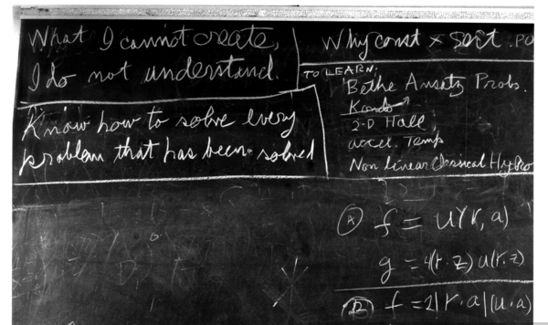

Slide 21
What are the parts of an agent-based model?

Slide 22
What are the parts of an agent-based model?
Key components:
Agents (and Environments)
Life cycle

Slide 23
Agents
What is an agent?
Autonomous entity:
People
Psychological mechanisms
Groups of people
Etc.
Autonomous entity

Slide 24
Agents
What are agents like?
Decision rules:
If hungry, search food
If find food, then eat
If not food, then die
If alive, reproduce
Etc.
Autonomous entity
Autonomous entity
Decision rules

Slide 25
Agents
What are agents like?
Features:
States (Hunger: 0 = Hungry; 1= full)
Traits (Movement Speed: 0-10 steps/tick)
Identities (Sheep vs. wolf)
Autonomous entity
Decision rules
Autonomous entity
Decision rules
Features

Slide 26
Agents
What are agents like?
Environment:
Other agents
Space
Opportunities (food, shelter)
Challenges (barriers, traps)
Autonomous entity
Decision rules
Features
Environment

Slide 27
What are the parts of an agent-based model?
Key components:
Agents
Life cycle
Key components:
Agents
Life cycle
Life Cycle
Autonomous entity
Decision rules
Features
Environment

Slide 28
Life cycles
Repeated series of decisions and behaviors
Broken into discrete stages
Each stage:
Agents behave/Environments update
Typically do so:
In response to previous stage
In preparation for next stage
All agents pass through each stage in a specified order

Slide 29
Life cycles
Forage
Forage: Move around and check for food
Consume: If you find food, eat it
Die: Die if you didn’t find food
Reproduce: Reproduce if you are still alive
Reproduce
Predator/
Prey
Consume
Die

Slide 30
Life cycles
Forage
Data Collection
Reproduce
Predator/
Prey
Consume
Die
x100
x100

Slide 31
How does one create agent-based models?

Slide 32
How does one create agent-based models?
What works for me:
1. Develop a model outline
2. Implement that model outline
Languages and software

Slide 33
Model Outline
A thorough but abstract description of your agent-based model
Should be complete enough for another person to write your model for you
Should include:
Purpose
Agents and Environment
Life cycle
Analysis

Slide 34
Model Outline
Purpose
1-3 sentences long
What psychological process do we think extrapolates into a complex downstream phenomenon?
What downstream phenomenon do we think is explained by some psychological process?
What, roughly, will the model do?

Slide 35
Model Outline
Purpose
Two parts:
1. One-sentence description of the purpose for writing this model
2. Brief, high-level description of what will happen in the model
Mate choice:
“Determine whether human mate choice is better explained by preference-random mate choice or preference-driven but constrained mate choice. Agents will select mates from a simulated mating market incorporating realistic constraints; mate choices will be either random or based on simulated mate preferences”

Slide 36
Model Outline
Agents and Environment:
A complete description of the agents and their environment
Everything necessary to generate your agents
Should include:
Population size and characteristics
Agent features
Environment features

Slide 37
Model Outline
Agents and Environment:
A complete description of the agents and their environment
Everything necessary to generate your agents
Predator/prey model:
“A population of 100 agents will be generated; 90 of these agents will be “sheep”, 10 will be “wolves.” Agents can be hungry or sated; all agents will start off hungry. Each agent will have a unique location in a 2-D field of grass, specified by X and Y coordinates. Agents will also have a food check variable that indicates whether there is food at their current location. For sheep, only grass counts as food; for wolves, only sheep count as food.”

Slide 38
Model Outline
Life cycles:
A description, stage-by-stage, of what will happen throughout the life cycle
Mate choice:
“1. Compute attraction
2. Select mates
3. Reproduce
4. Die
#Computing attraction#
Each agent will compute how attracted they are to all opposite-sex agents. Attraction will be calculated as the summed product of agent preferences and potential mate traits”

Slide 39
Model Outline
Analysis
A description of what model criteria will be analyzed and how
Predator/prey:
“At the end of each generation, the model will save (1) the amount of grass remaining uneaten, (2) the population size of sheep, and (3) the population size of wolves. After all generations are complete, the model will plot changes in these values across generations.”

Slide 40



Utility/Efficiency
Netlogo
Ease of use

Slide 42
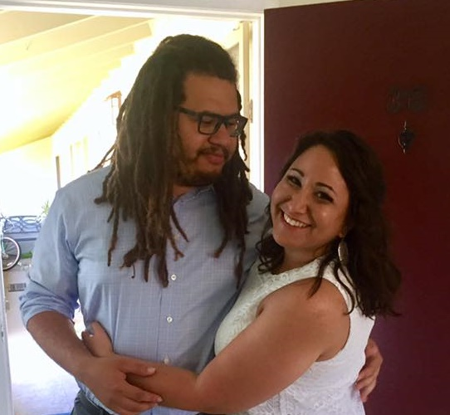
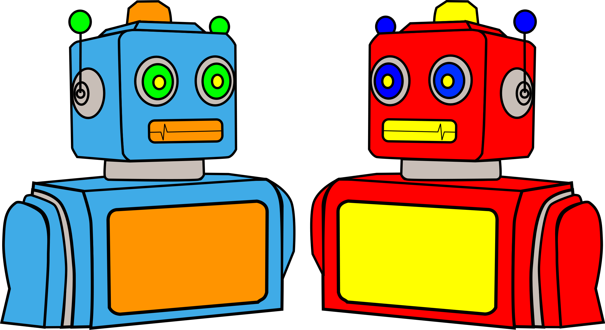
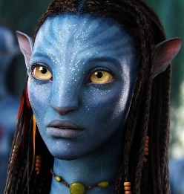
“Couple Simulation”
P
T
P
T
P
T
P
T

Slide 43
B
A
A
A
A
A
C
B
B
B
C
C
A
C
C
B
C
B
1. Observe True Relationships
2. Simulate
Mating Market
3. Assess
Accuracy

Slide 44
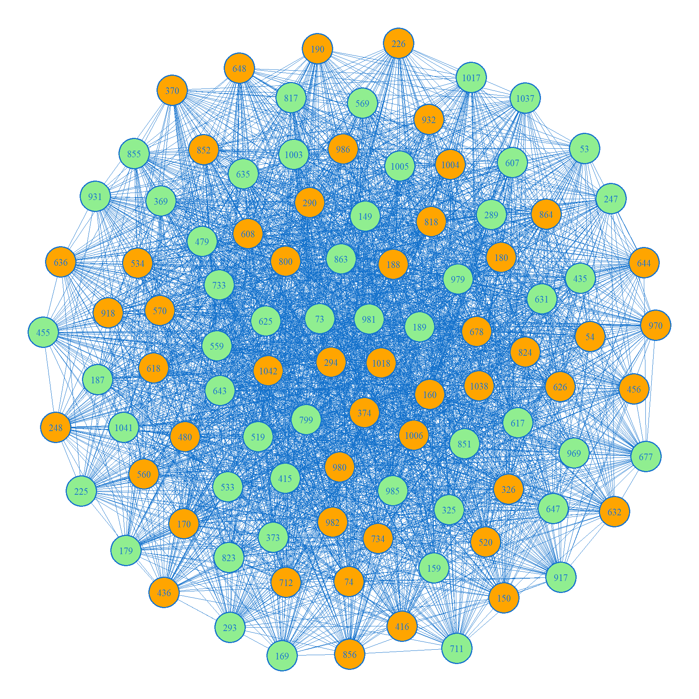

Slide 45
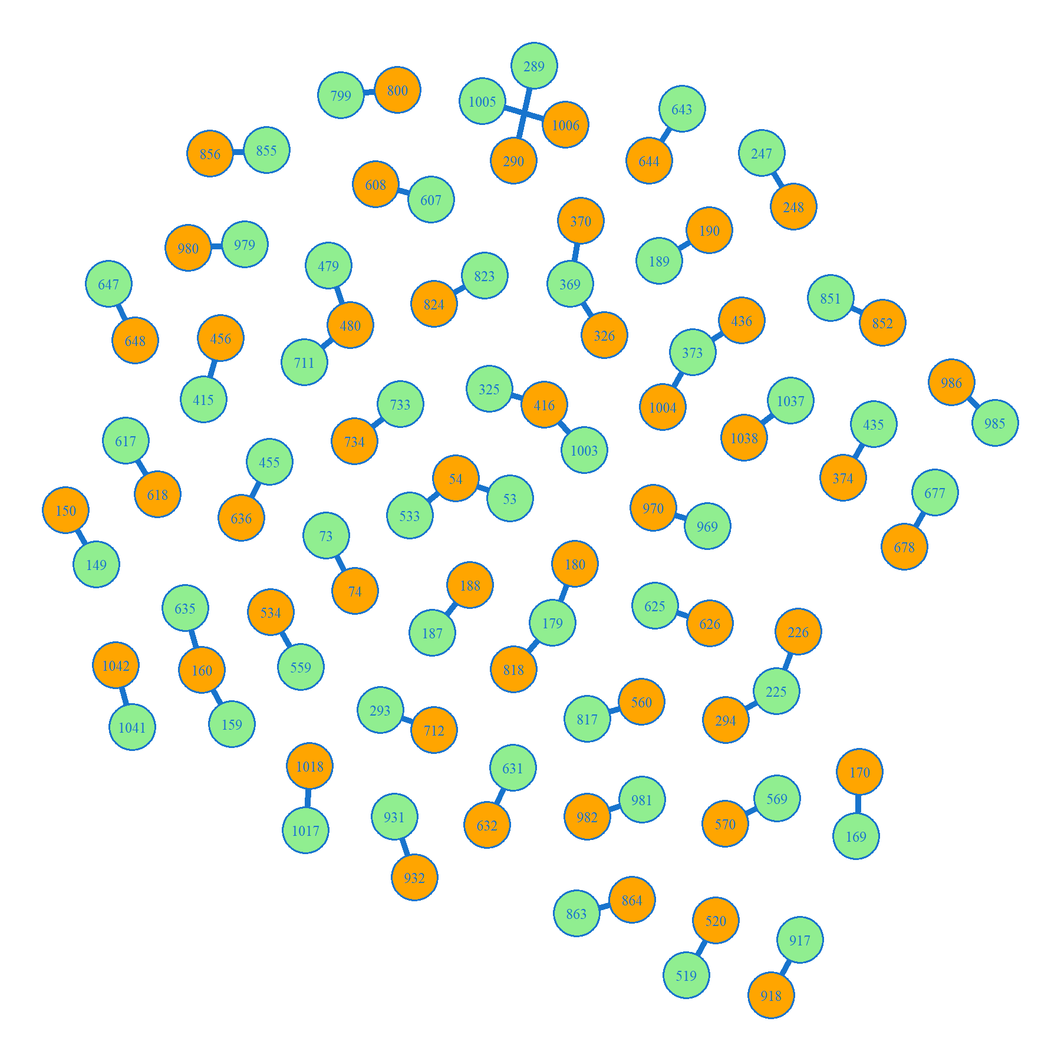
~76% simulation accuracy

